Slide 1
Deep Learning - Algorithms
Raghu Prasad K S

Slide 2
Introduction
Raghu Prasad – BE, MS
Total of 24 years of experience
7 years as a lecturer in Engineering College
17 Years into IT
Worked with companies like CISCO,CSC,ICICI,First Apex – NTT Data
Currently into Corporate training and consultancy
Worked with corporates and public sector
Technologies – Java,Python,Data Sciences,Web technologies,Java Script technologies (MEAN stack),IOT,Test Automation – Selenium,JMeter

Slide 3
Course Outline
Types of Machine Learning
Machine Learning Algorithms
Machine learning examples

Slide 4
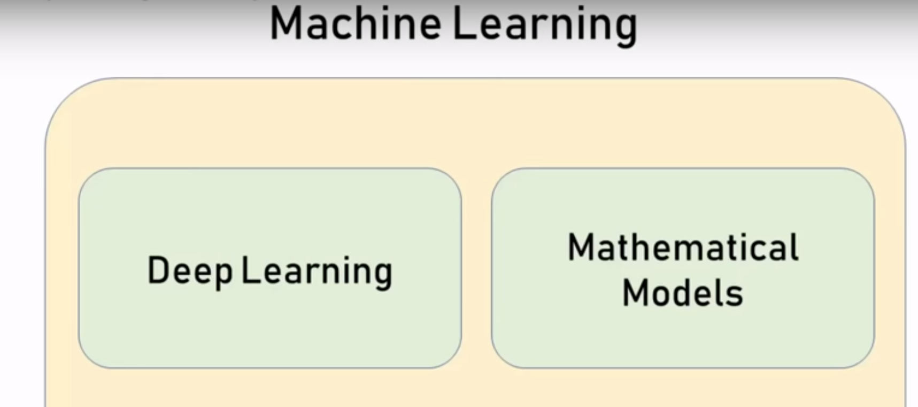
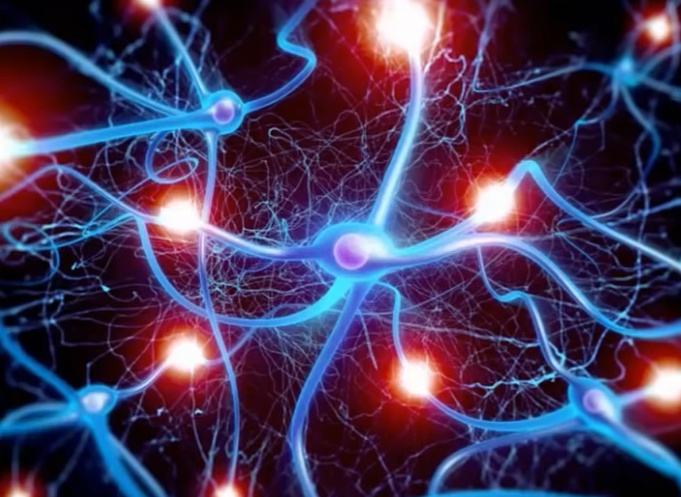
Deep Learning using Tensorflow and Keras

Slide 5
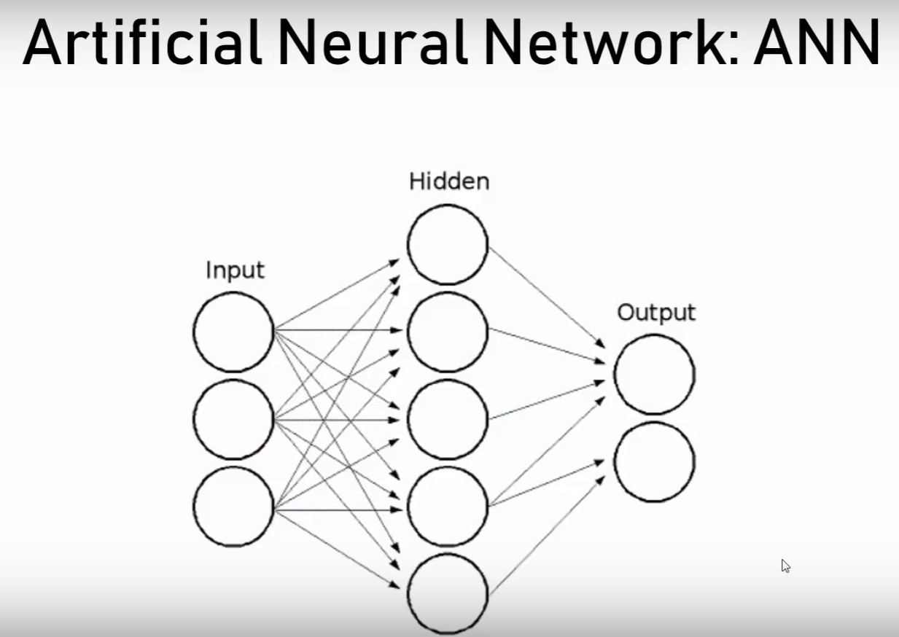
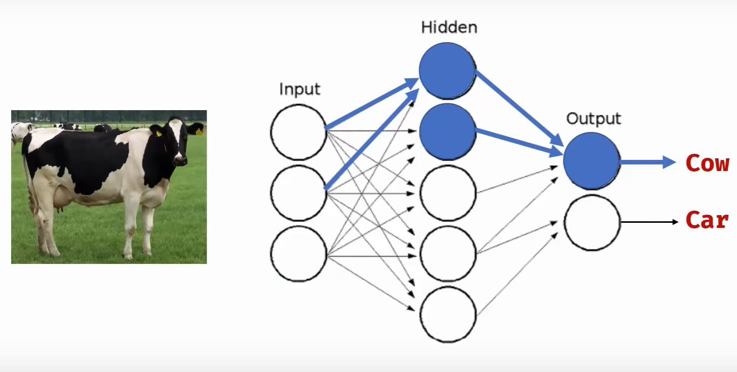
Deep Learning using Tensorflow and Keras

Slide 6
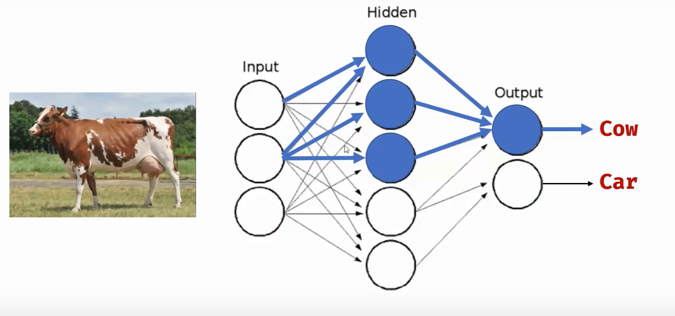
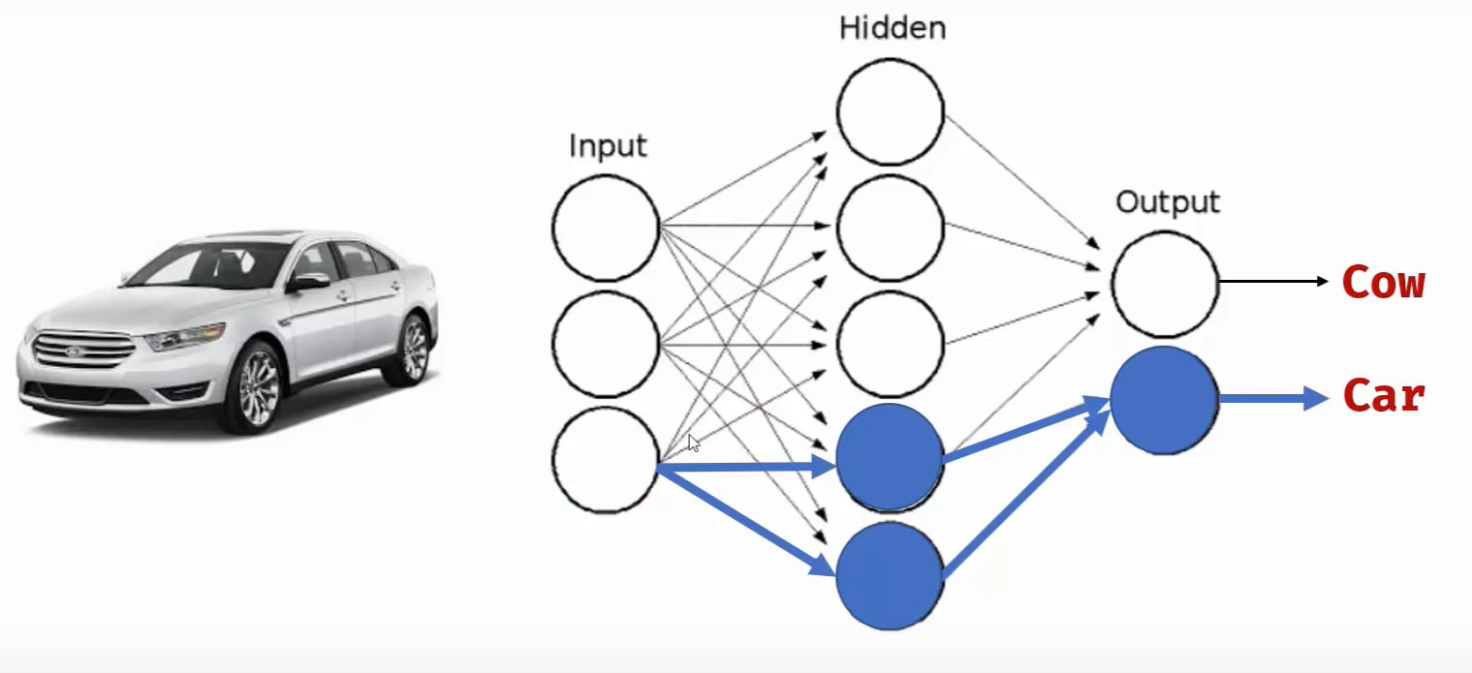
Deep Learning using Tensorflow and Keras

Slide 7
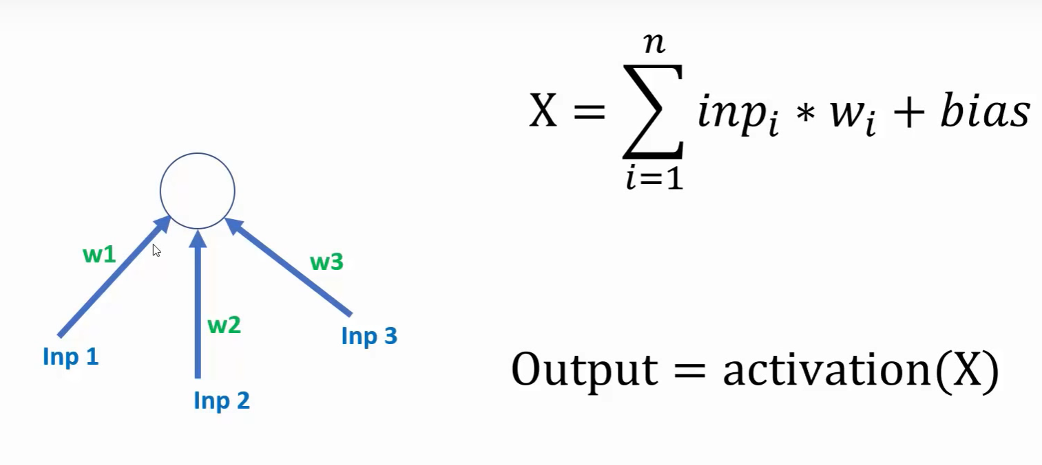
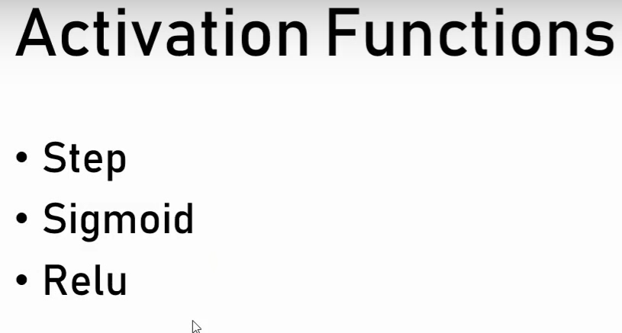
Deep Learning using Tensorflow and Keras

Slide 8
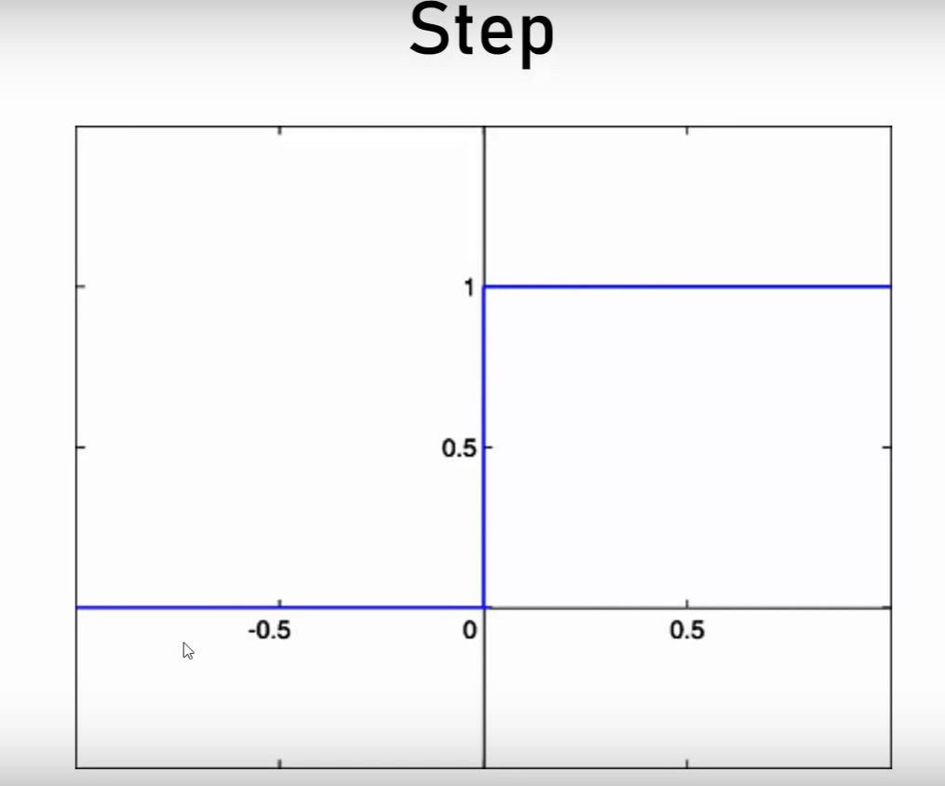
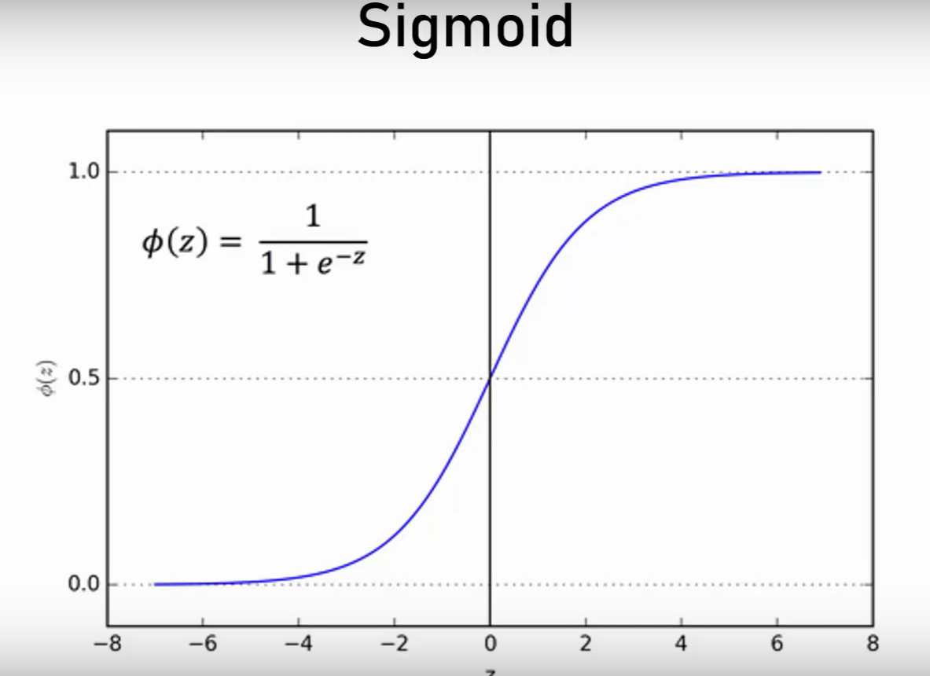
Deep Learning using Tensorflow and Keras

Slide 9
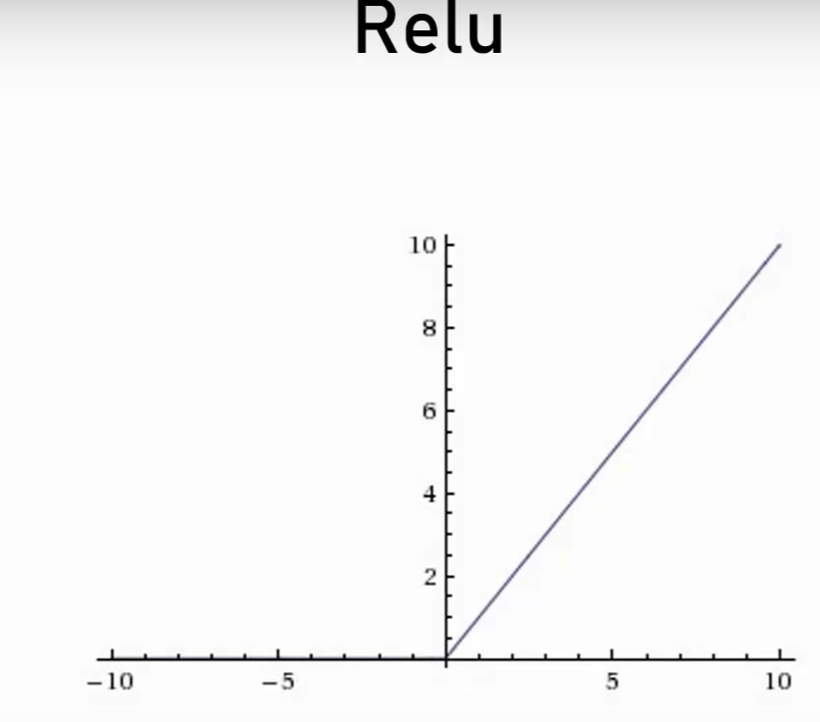
Deep Learning using Tensorflow and Keras

Slide 10
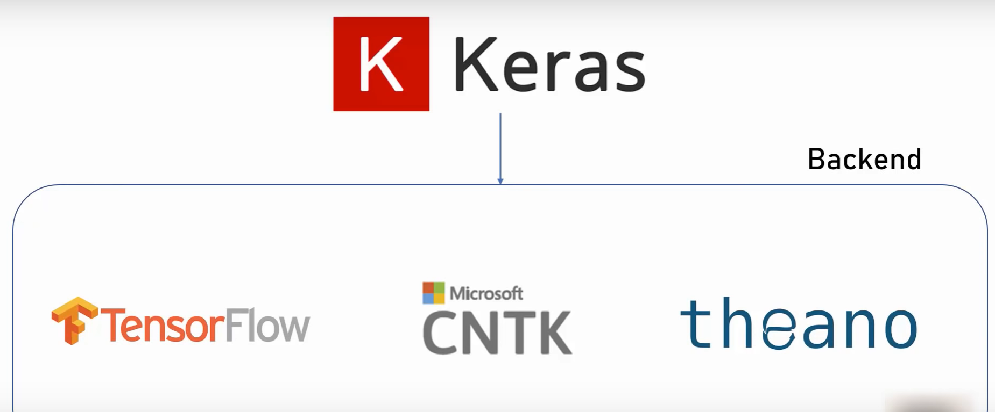
Deep Learning using Tensorflow and Keras

Slide 11
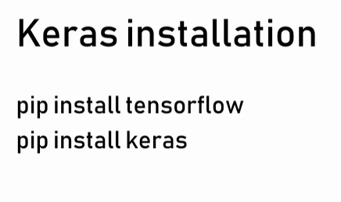
Deep Learning using Tensorflow and Keras

Slide 12
Thanks
Visit – www.kaushalya.tech
9845547471

